Slide 1

Multiple Access
12.<number>
Copyright © The McGraw-Hill Companies, Inc. Permission required for reproduction or display.

Slide 2

Figure 12.1 Data link layer divided into two functionality-oriented sublayers
12.<number>

Slide 3
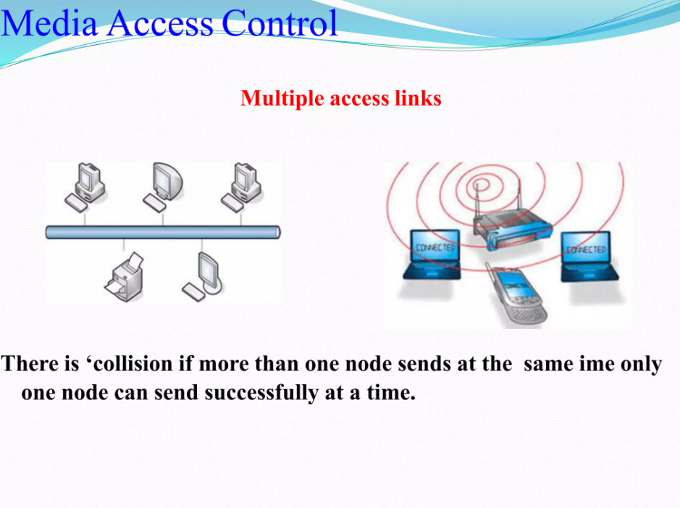

Slide 4
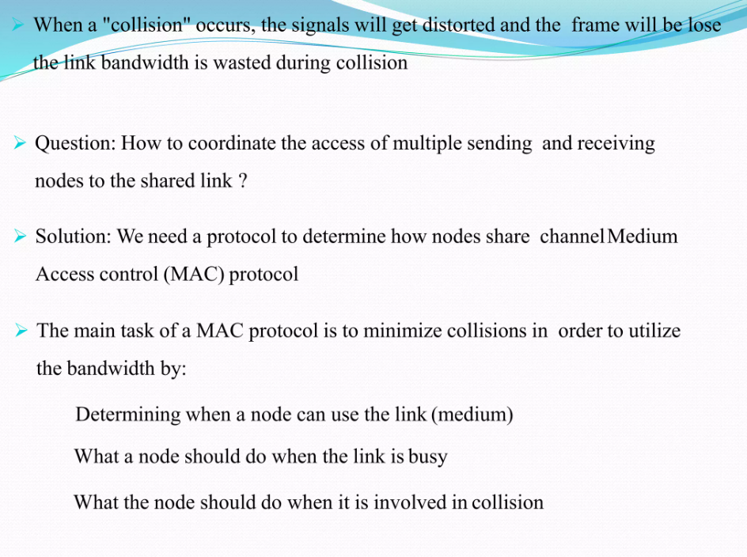


Slide 5

Figure 12.2 Taxonomy of multiple-access protocols discussed in this chapter
12.<number>

Slide 6
12-1 RANDOM ACCESS
In random access or contention methods, no station is superior to another station and none is assigned the control over another. No station permits, or does not permit, another station to send. At each instance, a station that has data to send uses a procedure defined by the protocol to make a decision on whether or not to send.
Topics discussed in this section:
ALOHA
Carrier Sense Multiple Access
Carrier Sense Multiple Access with Collision Detection
Carrier Sense Multiple Access with Collision Avoidance
12.<number>

Slide 7

Figure 12.3 Frames in a pure ALOHA network
12.<number>

Slide 8

Figure 12.4 Procedure for pure ALOHA protocol
12.<number>

Slide 9

Figure 12.5 Vulnerable time for pure ALOHA protocol
12.<number>

Slide 10

Note
The throughput for pure ALOHA is
S = G × e ^{−2G} .
The maximum throughput
S_{max} = 0.184 when G= (1/2).
12.<number>

Slide 11

Figure 12.6 Frames in a slotted ALOHA network
12.<number>

Slide 12
Note
The throughput for slotted ALOHA is
S = G × e^{−G} .
The maximum throughput
S_{max} = 0.368 when G = 1.
12.<number>

Slide 13

Figure 12.7 Vulnerable time for slotted ALOHA protocol
12.<number>

Slide 14

Figure 12.8 Space/time model of the collision in CSMA
12.<number>

Slide 15

Figure 12.9 Vulnerable time in CSMA
12.<number>

Slide 16

Figure 12.10 Behavior of three persistence methods
12.<number>

Slide 17

Figure 12.11 Flow diagram for three persistence methods
12.<number>

Slide 18

Figure 12.12 Collision of the first bit in CSMA/CD
12.<number>

Slide 19

Figure 12.14 Flow diagram for the CSMA/CD
12.<number>

Slide 20
Note
In CSMA/CA, the IFS can also be used to define the priority of a station or a frame.
12.<number>

Slide 21
Note
In CSMA/CA, if the station finds the channel busy, it does not restart the timer of the contention window;
it stops the timer and restarts it when the channel becomes idle.
12.<number>

Slide 22

Figure 12.17 Flow diagram for CSMA/CA
12.<number>

